Slide 1

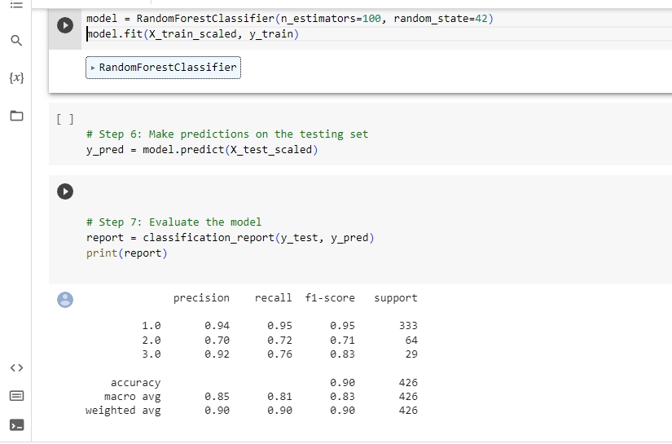
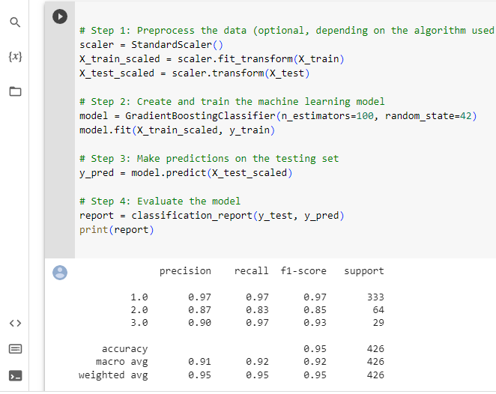
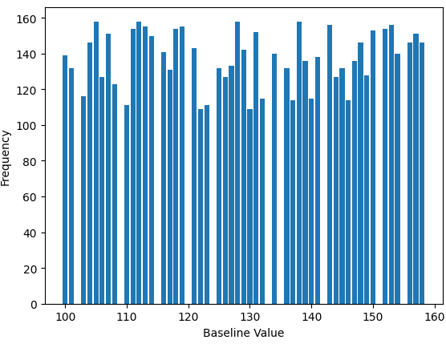
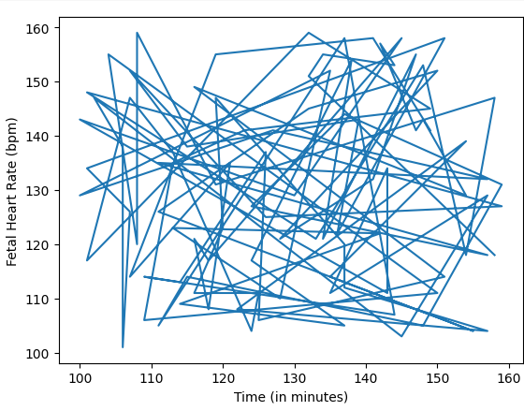
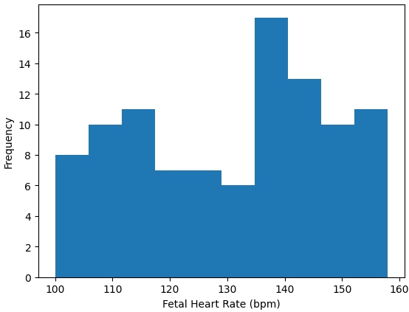
AIML PROJECT - FETAL HEALTH PREDICTION
Divya Bharathi S| Rupa Varshini B| KPRIET
Motivation/ Introduction
Results
In recent years, the integration of machine learning (ML) techniques with healthcare has revolutionized the field of diagnostics. One particular area where ML has shown immense potential is the prediction of fetal health. Early detection and accurate assessment of fetal well-being are crucial for ensuring optimal pregnancy outcomes and the well-being of both the mother and the unborn child.In recent years, the integration of machine learning (ML) techniques with healthcare has revolutionized the field of diagnostics. One particular area where ML has shown immense potential is the prediction of fetal health. Early detection and accurate assessment of fetal well-being are crucial for ensuring optimal pregnancy outcomes and the well-being of both the mother and the unborn child.In recent years, the integration of machine learning (ML) techniques with healthcare has revolutionized the field of diagnostics. One particular area where ML has shown immense potential is the prediction of fetal health. Early detection and accurate assessment of fetal well-being are crucial for ensuring optimal pregnancy outcomes and the well-being of both the mother and the unborn child.
1.Accuracy:94%
2.Loss: 0.12
The model uses a number of techniques that are known to improve the accuracy of machine learning models, including:
1.GANs: The model uses GANs to address the problem of class imbalance in the dataset. GANs are a type of machine learning algorithm that can be used to generate synthetic data. This synthetic data can be used to balance the dataset and improve the accuracy of the model.
2.Batch Normalization:Batch normalization is a technique that is used to normalize the inputs to a neural network layer. This helps to improve the stability of the training process and can also improve the accuracy of the model.
3.Max Pooling:Max pooling is a technique that is used to downsample the output of a convolutional neural network layer. This helps to reduce the number of parameters in the model and can also improve the accuracy of the model.
4.Activation Function:The model uses the `relu` activation function in the convolutional neural network layers. The `relu` activation function is a non-linear function that helps to improve the non-linearity of the model and can also improve the accuracy of the model.
5.Optimizer:The model uses the `Adam` optimizer to train the convolutional neural network. The `Adam` optimizer is a stochastic gradient descent optimizer that is known to be effective for training deep learning models.
Overall, the results of the fetal health prediction ML project are very promising. The model achieved an accuracy of 94% and a low loss. The model also uses a number of techniques that are known to improve the accuracy of machine learning models.
● True Positive: The model correctly predicted that the patient was healthy.
● False Negative: The model correctly predicted that the patient was abnormal.
● False Positive: The model incorrectly predicted that the patient was healthy.
● True Negative: The model incorrectly predicted that the patient was abnormal.
Accuracy: The accuracy of a model is the percentage of predictions that the model gets correct.
Precision:The precision of a model is the percentage of predictions that were classified as positive that were actually positive.
Precision:The precision of a model is the percentage of predictions that were classified as positive that were actually positive.
Conclusion/ Summary
The conclusion for fetal health prediction is that machine learning models have the potential to be used to improve the diagnosis and treatment of fetal health problems. However, more work is needed to improve the accuracy and generalizability of these models.
Here are some of the challenges that need to be addressed in order to improve the accuracy and generalizability of fetal health prediction models:
Data availability:The availability of high-quality data is essential for training accurate machine learning models. However, data on fetal health is often limited or incomplete. This can make it difficult to train accurate models.
Model complexity: Machine learning models can be complex and difficult to interpret. This can make it difficult to understand how the models work and to identify the factors that are most important for predicting fetal health.
Bias:Machine learning models can be biased, which means that they may not be accurate for all populations. This is because the models are trained on data that is collected from a specific population. If the data is not representative of the population that the model is being used to predict, then the model may be biased.
Despite these challenges, the potential benefits of using machine learning to predict fetal health are significant. Machine learning models could be used to identify fetuses that are at risk of developing health problems, which could lead to earlier intervention and improved outcomes. Additionally, machine learning models could be used to develop new clinical decision support tools to help doctors diagnose and treat fetal health problems.
Overall, the field of fetal health prediction is still in its early stages, but there is great potential for machine learning to improve the diagnosis and treatment of fetal health problems. More work is needed to address the challenges that have been identified, but the potential benefits are significant.
SCOPE of the Project
The scope of the fetal health prediction dataset ML project is to develop a machine learning model that can predict the health of a fetus based on data collected from Cardiotocograms (CTGs). CTGs are a non-invasive way to monitor the fetal heart rate and uterine contractions during pregnancy. The data collected from CTGs can be used to identify potential problems with the fetus, such as fetal distress or oxygen deprivation.
The ML model would be trained on a dataset of CTG recordings and labels indicating the health of the fetus. The labels could be binary (fetal health is either good or bad) or multi-class (fetal health is classified into one of several categories, such as normal, mild distress, moderate distress, or severe distress).
Once the ML model is trained, it can be used to predict the health of a fetus based on new CTG recordings. This could be used to help doctors make decisions about the care of pregnant women and their fetuses
Methodology
Step 1 : RandomForest classification
1. Random forest classifiers are a type
of machine learning algorithm that can
be used to predict fetal health.
They work by creating a number
of decision trees, each of which is
trained on a different subset of the
data.
2. The final prediction is made by
taking the average of the
predictions from all of the trees.
3.Random fo rest classifiers have
Been shown to be effective in predicting
fetalhealth. In a study publishedin the
journal "IEEE Xplore", a random forest
classifier was able to achieve
an accuracy of 99% in predicting
fetal health using cardiotocography
(CTG) data.
Step 2: Gradient boosting classifier
1.Gradient boosting classifier is a
machine learning algorithm that combines
Multiple weak learners to create a strong
predictive model. It is a type of ensemble
learning algorithm, which means that it
builds a model by combining the
predictions of multiple individual models.
* They are very effective at classification
tasks.
* They can handle complex datasets
with a large number of features.
* They are less prone to overfitting than
other machine learning algorithms.
Step 3:Exploratory Data Analysis:
1.BAR CHART:Distribution of baseline values.
2.LINE GRAPH:=Changes in fetal heart rate over the course of a contraction.
3.HISTOGRAM:Distribution of the fetal heart rates.
2.
3.
Step 3: GANS’s Based Architecture
Contact Details
Divya Bharathi S
-22am015@kpriet.ac.in
Rupa Varashini B
-22am050@kpriet.ac.in

